Slide 1
Picture Viewer

Slide 2
Create a new project
Test an program
Add basic controls like check boxes and buttons
Position controls on a form using layouts
Add Open File and Color dialog boxes
Write code

Slide 3
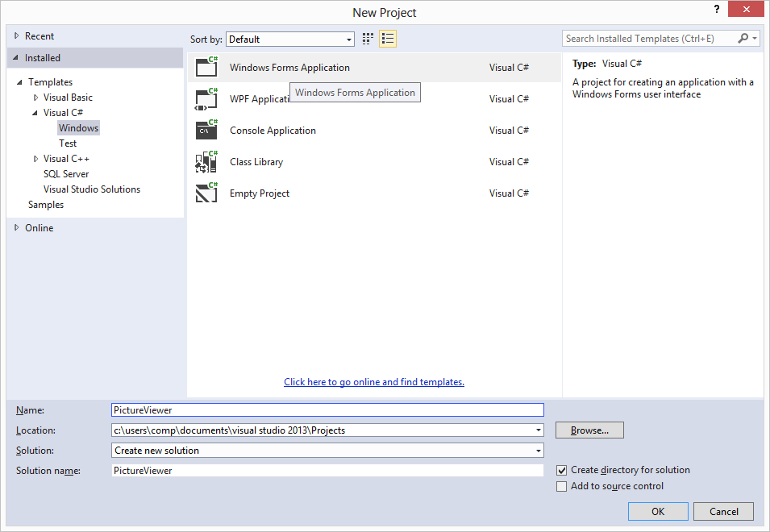
Create a Windows Forms Application

Slide 4
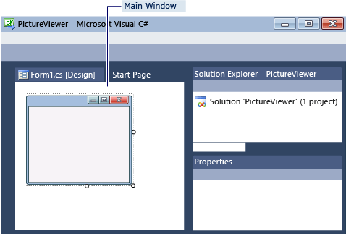
Interface
Main window
เป็นหน้าจอออกแบบ Form เขียน code
Solution Explorer
แสดงสิ่งต่างๆ ที่อยู่ใน solution เช่นไฟล์ต่างๆ
Properties window
เราสามารถเปลี่ยน properties ของสิ่งของที่เลือก

Slide 5
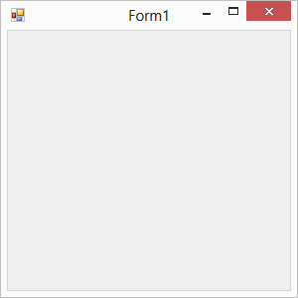
Run Your Program
File-> Save All
F5
  choose Start Debugging
Stop Program
  Stop Debugging
  Choose X button in the upper corner of Form1

Slide 6
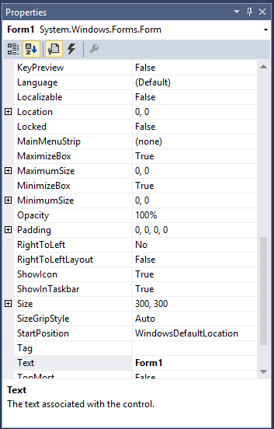
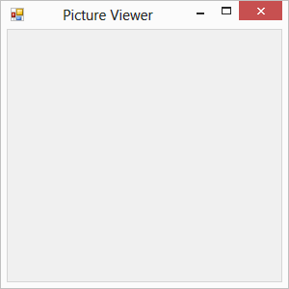
Set Your Form Properties
Choose the Form1.cs[Design]
Choose anywhere inside form Form1
Choose Text, type Picture Viewer

Slide 7
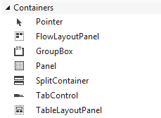
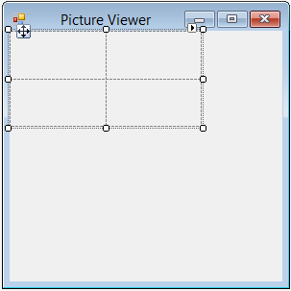
Lay Out Your Form
View->Toolbox
Containers
  TableLayoutPanel
  Double click

Slide 8
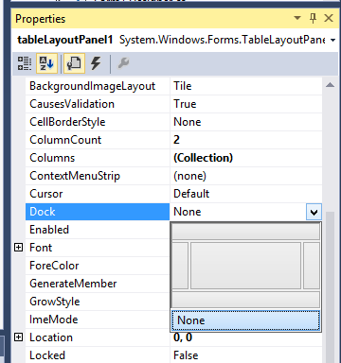
Choose the Alphabetical button
Dock property
None->Fill

Slide 9
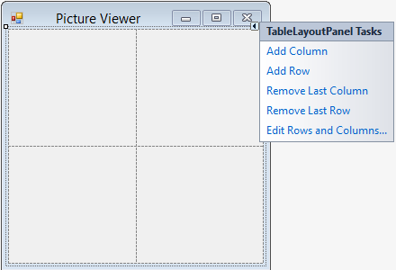
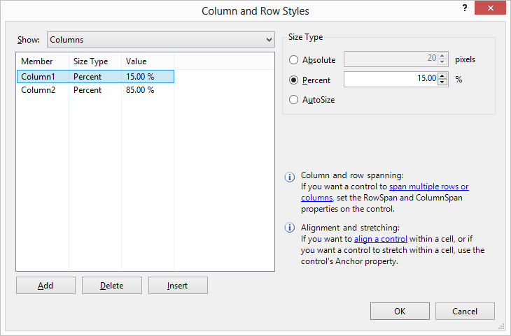
Choose Triangle-> Edit Rows and Columns
Row1 90 % Row2 10%

Slide 10
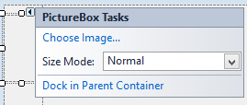
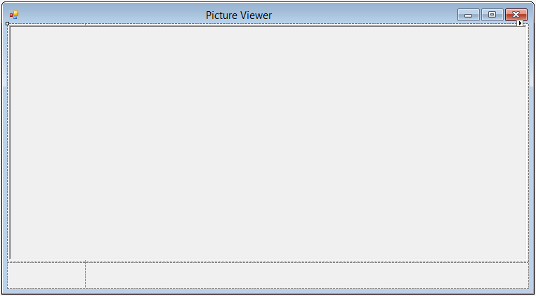
Insert PictureBox
Choose Dock in Parent Container
PictureBox->Dock->Fill
PictureBox->ColumnSpan->2
PictureBox-BorderStyle->Fixed3D

Slide 11
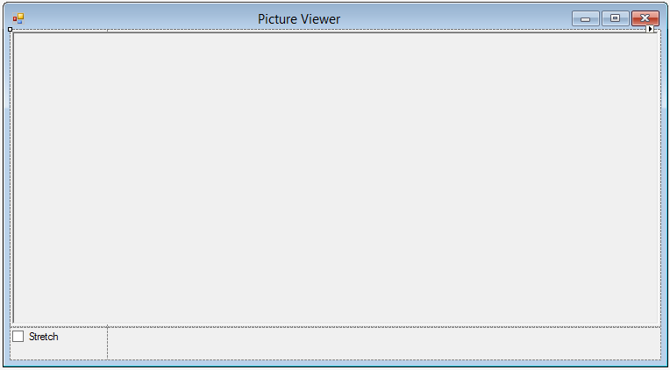
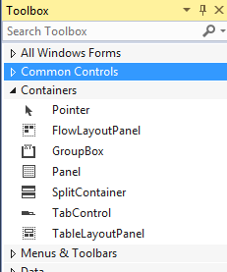
Double Click CheckBox
  Text->Stretch
Container
  FlowLayoutPanel
  Dock->Fill

Slide 12
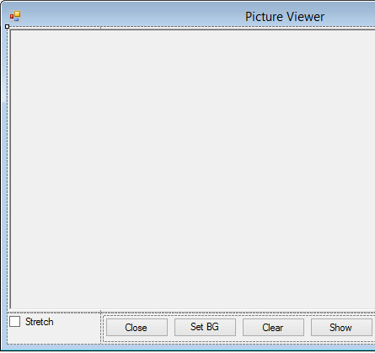
To Add Buttons
Choose FlowLayoutPanel
Double Click Button to Add
Set Text Close, Set BG Color, Clear, Show
AutoSize=true

Slide 13
Name Your Button Controls
choose button
(name)
  closeButton
  backgroundButton
  clearButton
  showButton
Double click showButton

Slide 14
private void clearButton_Click(object sender, EventArgs e)
{
}
private void backgroundButton_Click(object sender, EventArgs e)
{
}
private void closeButton_Click(object sender, EventArgs e)
{
}
private void checkBox1_CheckedChanged(object sender, EventArgs e)
{
}

Slide 15
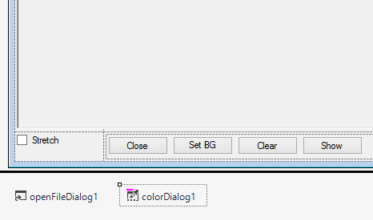
Add Dialog Components
Dialogs
  double click openFileDialog, colorDialog

Slide 16
openFileDialog
  Filter
  JPEG Files (*.jpg)|*.jpg|PNG Files (*.png)|*.png|BMP Files (*.bmp)|*.bmp|All files (*.*)|*.*
  Title
  Select a picture file

Slide 17
Write Code
private void showButton_Click(object sender, EventArgs e)
{
if (openFileDialog1.ShowDialog() == DialogResult.OK)
{
pictureBox1.Load(openFileDialog1.FileName);
}
}
private void closeButton_Click(object sender, EventArgs e)
{
this.Close();
}

Slide 18
private void clearButton_Click(object sender, EventArgs e)
{
// Clear the picture.
pictureBox1.Image = null;
}
private void backgroundButton_Click(object sender, EventArgs e)
{
if (colorDialog1.ShowDialog() == DialogResult.OK) pictureBox1.BackColor = colorDialog1.Color;
}

Slide 19
private void checkBox1_CheckedChanged(object sender, EventArgs e)
{
if (checkBox1.Checked)
pictureBox1.SizeMode = PictureBoxSizeMode.StretchImage;
else
pictureBox1.SizeMode = PictureBoxSizeMode.Normal;
}

