Slide 1
Introduction to Database
C# MySQL
http://www.codeproject.com/Articles/43438/Connect-C-to-MySQL

Slide 2
โครงสร้างฐานข้อมูลเชิงสัมพันธ์
Relational Data Model
ข้อมูลถูกจัดเก็บในฐานข้อมูลในรูปแบบตาราง (Table)
  ในแต่ละตารางประกอบ Field (หรือ Attribute) ต่างๆ
  และแต่ละ Field อาจจะมีชนิดของข้อมูล (Data Type)
  ที่แตกต่างกันไป
  ข้อมูลที่จัดเก็บอยู่ในแต่ละตาราง ถูกจัดเก็บใน
  รูปแบบของ Record (หรือ Row หรือ Tuple)

Slide 3
ชนิดของข้อมูล (Data Type)
Data Type
  Numeric data types for integers and real numbers
  Characters
  Booleans
  Fixed-length strings
  Variable-length strings
  Date, time, timestamp
  Money
  Other special data types

Slide 4
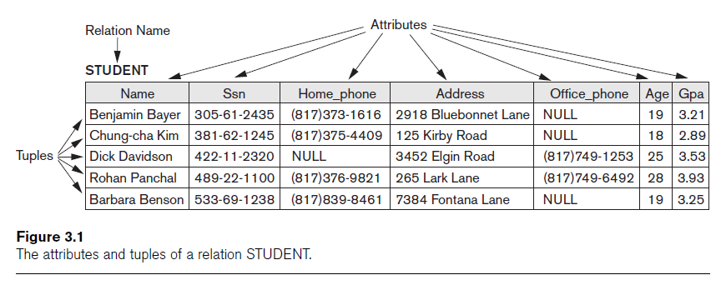
ตัวอย่าง Table
(Fields)
(Records)
หมายเหตุ: NULL หมายถึง ไม่มีข้อมูล (Empty)

Slide 5

MySQL
MySQL, the most popular Open Source SQL database management system, is developed, distributed, and supported by Oracle Corporation.
MySQL databases are relational.
ฐานข้อมูลที่สร้างขึ้นโดยใช้ MySQL ถูกจัดเก็บอยู่ในรูปแบบของ Relational Database

Slide 6
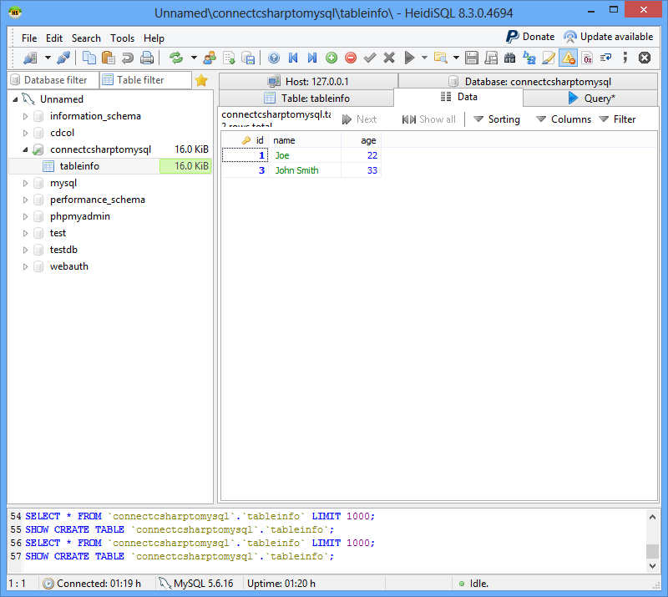
HeidiSQL
HeidiSQL is a useful and reliable tool designed for web developers using the popular MySQL server, and Microsoft SQL databases. It enables you to browse and edit data, create and edit tables, views, procedures, triggers and scheduled events. Also, you can export structure and data either to SQL file, clipboard or to other servers.
Main Features
Connect to multiple servers in one window.
Connect to servers via command line.
Create and edit tables, views, stored routines,
triggers, and scheduled events.
Export from one server/database directly to
another server/database.
Manage user-privileges.
Import text-files.
Export table rows as CSV, HTML, XML, SQL, LaTeX,
Wiki Markup, and PHP Array.
Browse and edit table-data using a comfortable
grid.
Bulk edit tables (move to db, change engine,
collation etc.)
And much more

Slide 7
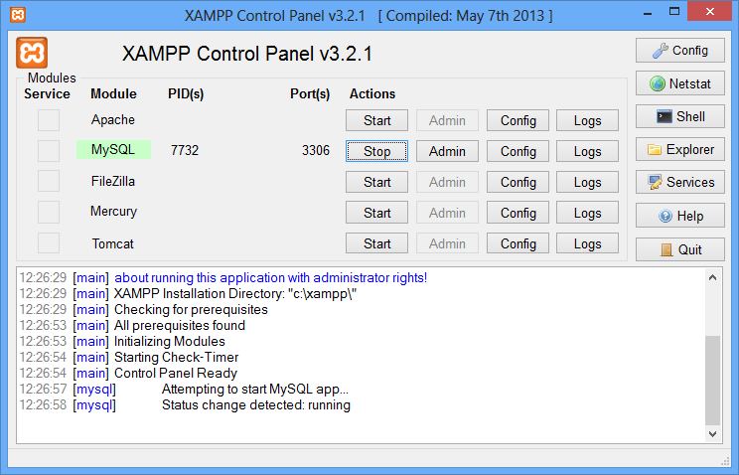
Using HeidiSQL to Maintain MySQL Database Server
First, start XAMPP web server.
XAMPP is a free and open source cross-platform web server solution stack package, consisting mainly of the Apache HTTP Server, MySQL database, and interpreters for scripts written in the PHP and Perl programming languages.

Slide 8
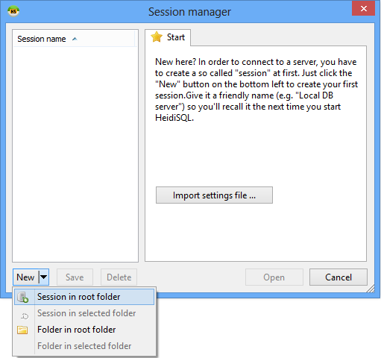
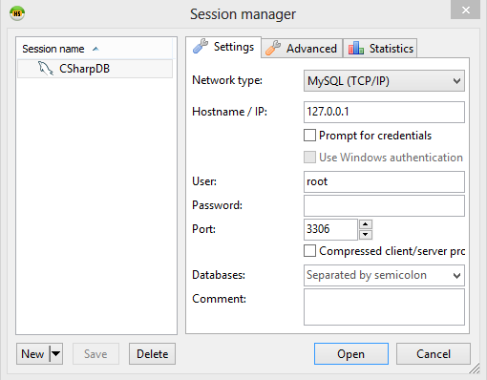
Create Session for connecting to MySQL Database Server using HeidiSQL

Slide 9
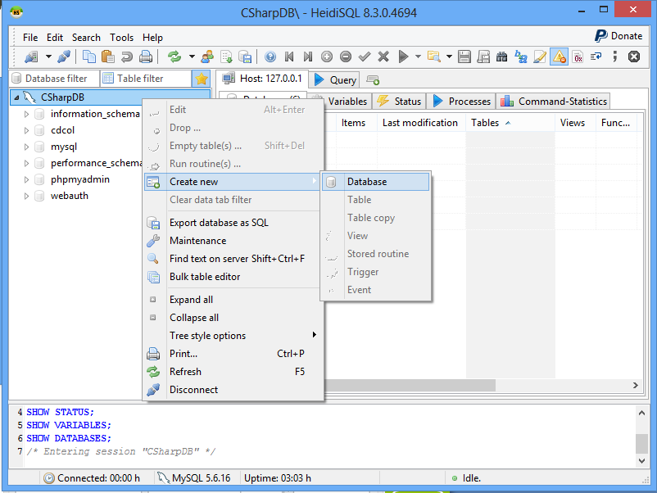
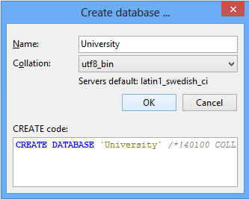
Create MySQL Database Server using HeidiSQL
เพื่อให้ Support ภาษาไทย

Slide 10
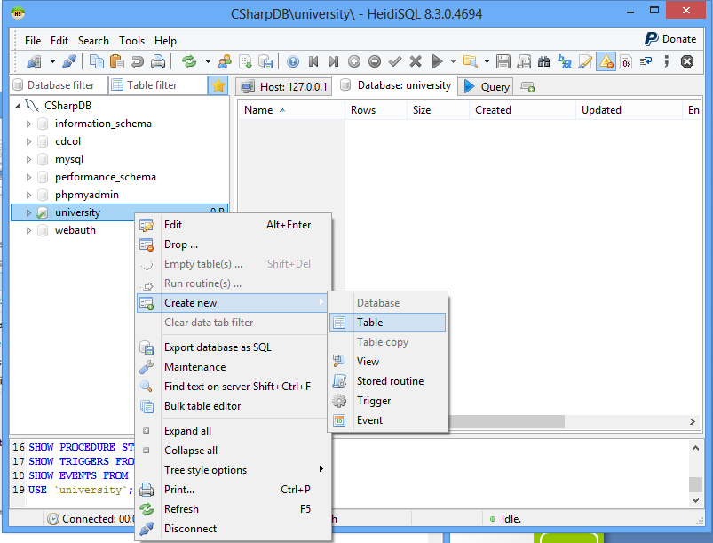
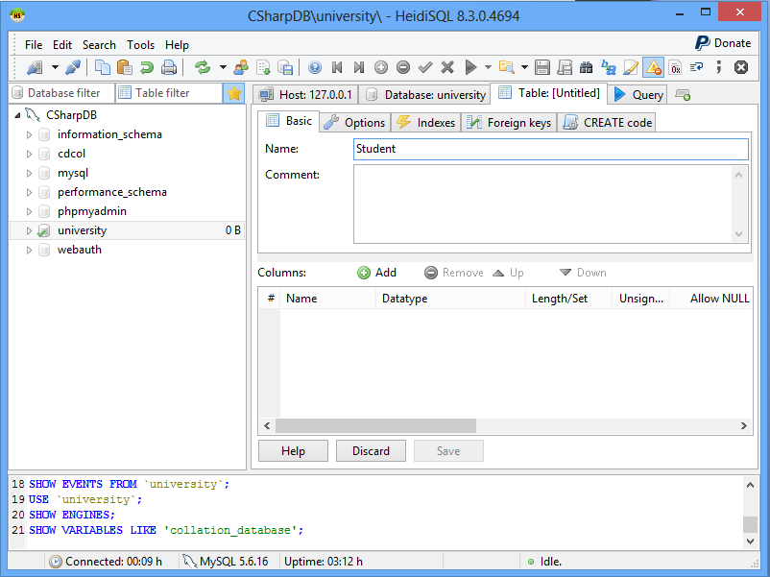
Create Table

Slide 11
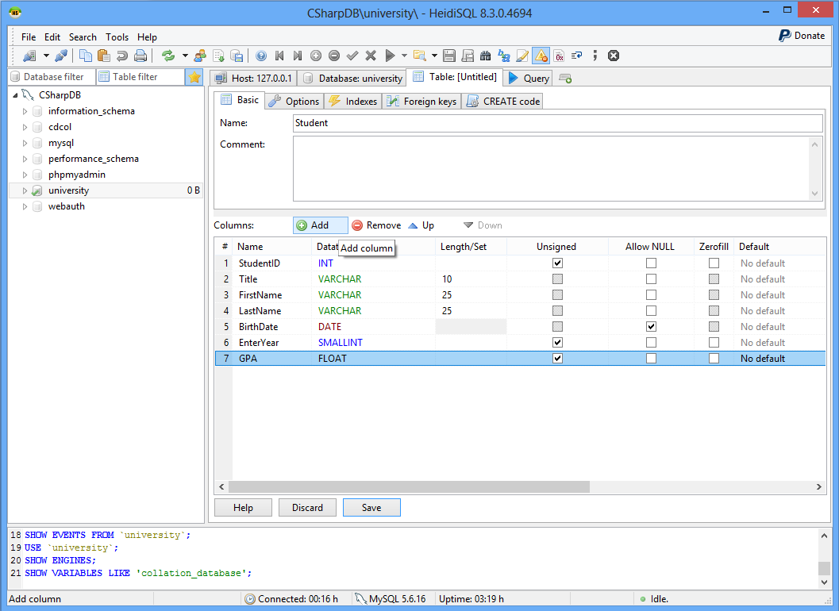
Create Fields

Slide 12
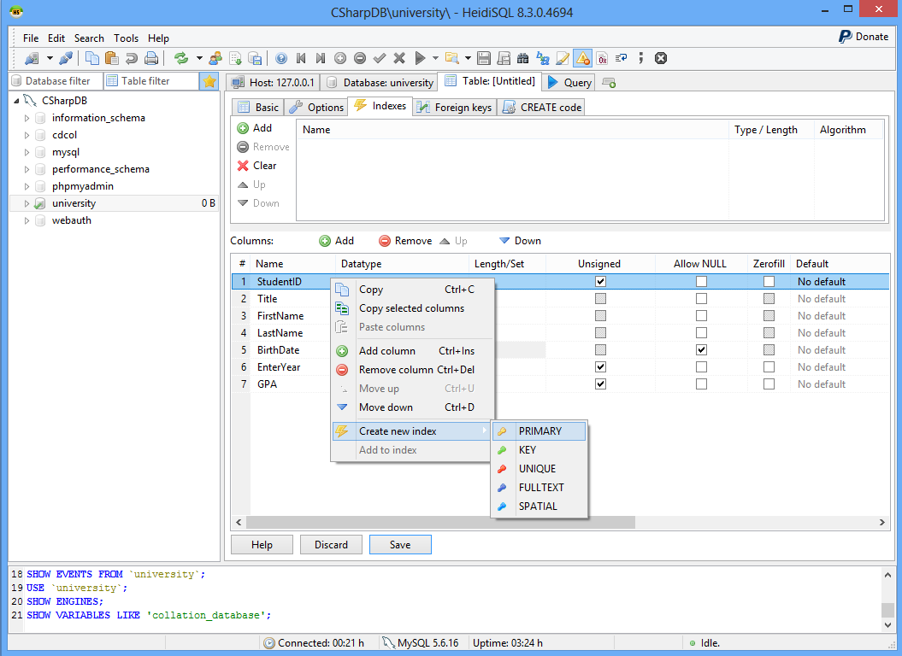
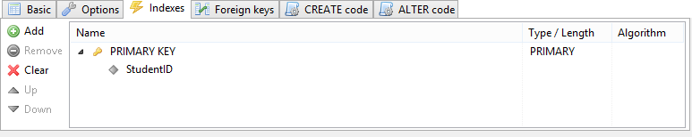
Create Primary Key

Slide 13
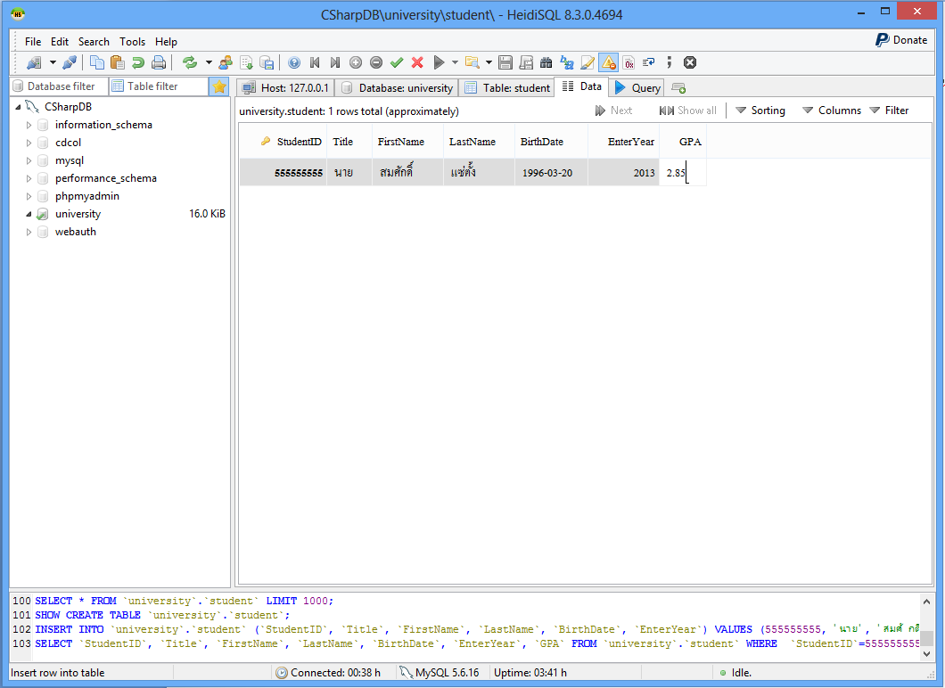
Maintaining Data using HeidiSQL

Slide 14
Maintaining Data using SQL Command - Insert
Insert Command
Approach 1
Insert into Table Name
Values (data₁, data₂, …, data_{n})
Approach 2
Insert into Table Name (Field₁, Field₂, …, Field_{n})
Values (data₁, data₂, …, data_{n})

Slide 15
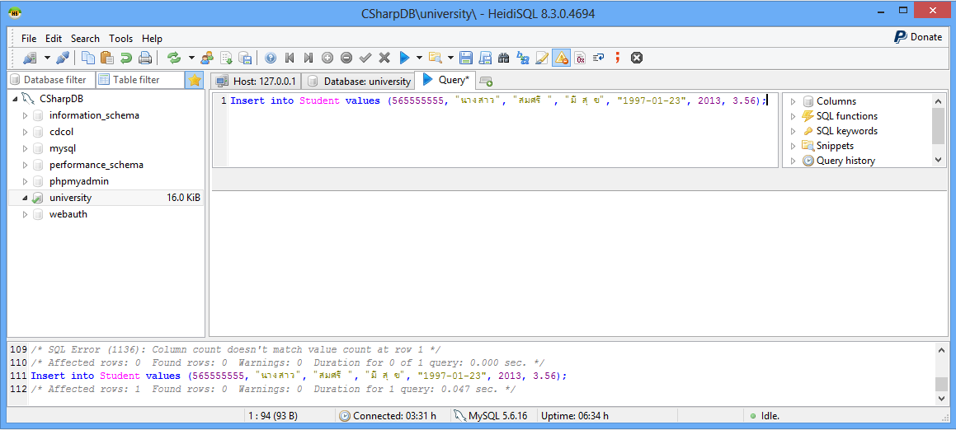
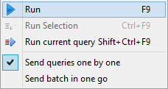
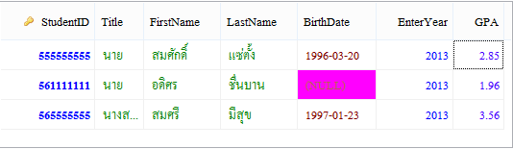
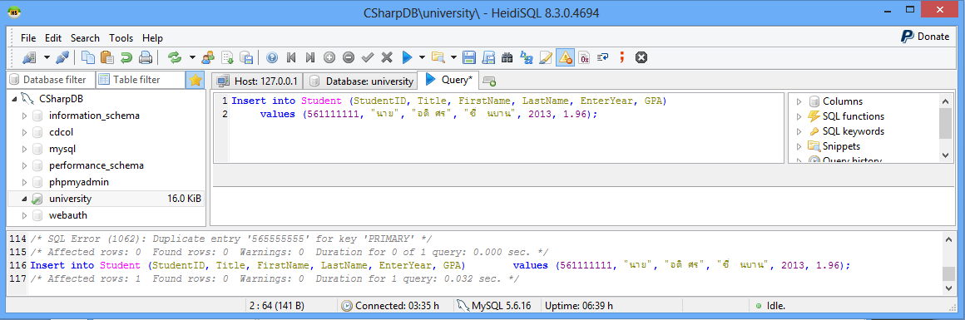
Maintaining Data using SQL Command - Insert
Approach 1
Approach 2

Slide 16
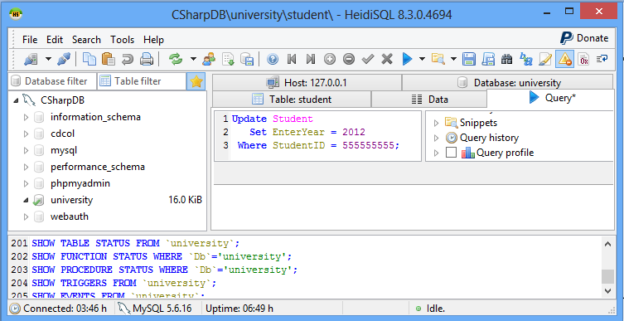
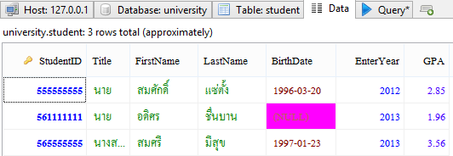
Maintaining Data using SQL Command - Update
Update Command
Update Table Name
Set Attribute Name = New Value
Where Condition; // ถ้าไม่มีเงื่อนไข จะ update ทุก record (ระวัง!!!)

Slide 17
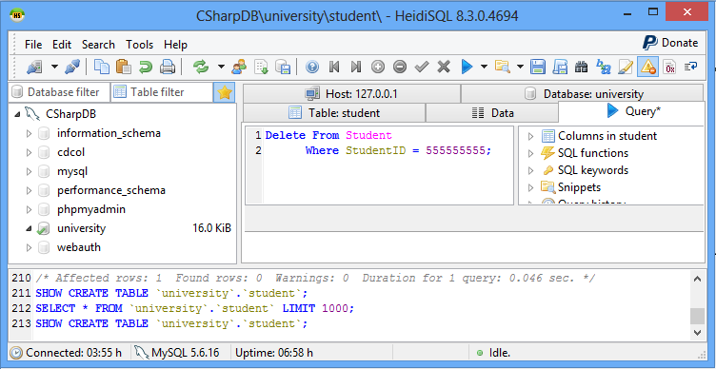
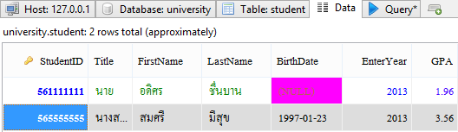
Maintaining Data using SQL Command - Delete
Delete Command
Delete From Table Name
Where Condition; // ถ้าไม่มีเงื่อนไข จะ delete ทุก record (ระวัง!!!)
ก่อนลบ
หลังลบ

Slide 18
การสืบค้นข้อมูล (Query) - Select
Select Command
Select *
From Table Name; // มาทุก Record, ทุก Field
Select Attribute List
From Table Name; // มาทุก Record, เฉพาะ Field ที่ระบุหลัง Select
Select *
From Table Name;
Where Condition; // มาทุก Field แต่มาเฉพาะ Record ที่ตรงตามเงื่อนไข
Select Attribute List
From Table Name;
Where Condition; // มา เฉพาะ Field ที่ระบุหลัง Select และมาเฉพาะ Record ที่ตรงตามเงื่อนไข

Slide 19
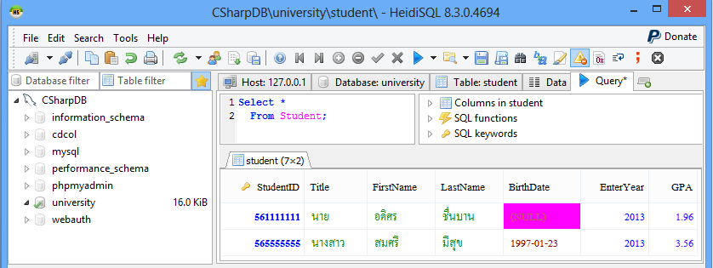
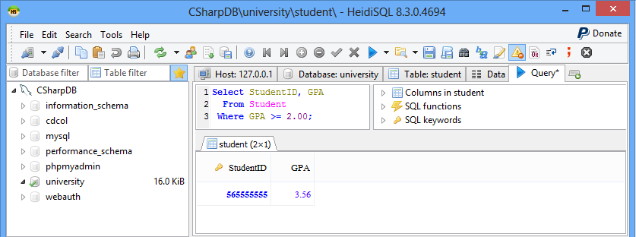
การสืบค้นข้อมูล (Query) - Select

Slide 20
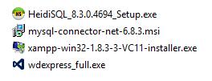
Downloading Connector/Net
First make sure you have downloaded and installed the MySQL Connector/NET (Database Driver) from the MySQL
http://dev.mysql.com/downloads/connector/net/6.1.html
ตอนนี้มีตัว update กว่านี้แล้ว

Slide 21
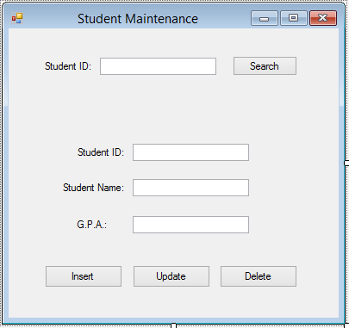
สร้าง Form

Slide 22
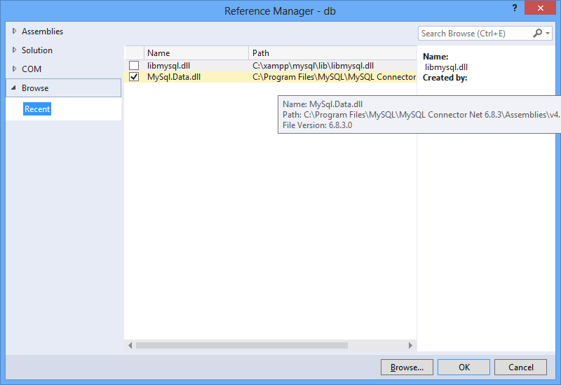
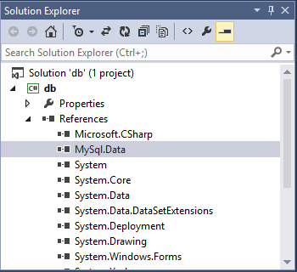
ตัวอย่าง Browse ไปที่ C:\Program Files\MySQL\MySQL Connector Net 6.8.3\Assemblies\v4.5

Slide 23
//Add MySql Library
using MySql.Data.MySqlClient;
Then declaring and initializing the variables that we will use:
connection: will be used to open a connection to the database.
server: indicates where our server is hosted, in our case, it's localhost.
database: is the name of the database we will use, in our case it's the database we already created earlier which is connectcsharptomysql.
uid: is our MySQL username.
password: is our MySQL password.
connectionString: contains the connection string to connect to the database, and will be assigned to the connection variable.

Slide 24
private MySqlConnection connection;
private string server;
private string database;
private string uid;
private string password;
public Form1()
{ InitializeComponent();
server = "localhost";
database = “university";
uid = "root";
password = "";
string connectionString;
connectionString = "SERVER=" + server + ";" + "DATABASE=" +
database + ";" + "UID=" + uid + ";" + "PASSWORD=" +password+ ";charset=tis620;";
connection = new MySqlConnection(connectionString);
}

Slide 25
Working with Insert, Update, Select, Delete
Usually, Insert, update and delete are used to write or change data in the database, while Select is used to read data.
For this reason, we have different types of methods to execute those queries.
The methods are the following:
ExecuteNonQuery: Used to execute a command that will not return any data, for example Insert, update or delete.
ExecuteReader: Used to execute a command that will return 0 or more records, for example Select.
ExecuteScalar: Used to execute a command that will return only 1 value, for example Select Count(*).

Slide 26
private bool OpenConnection()
{
try
{
connection.Open();
return true;
}
catch (MySqlException ex)
{
//When handling errors, you can your application's response based on the //error number.
//The two most common error numbers when connecting are as follows:
//0: Cannot connect to server.
//1045: Invalid user name and/or password.
switch (ex.Number)
{
case 0:
MessageBox.Show("Cannot connect to server. Contact administrator");
break;
case 1045:
MessageBox.Show("Invalid username/password, please try again");
break;
}
return false;
}
}

Slide 27
private bool CloseConnection()
{
try
{
connection.Close();
return true;
}
catch (MySqlException ex)
{
MessageBox.Show(ex.Message);
return false;
}
}

Slide 28
C# Programming
Steps
Start with Insert, update and delete, which are the easiest. The process to successfully execute a command is as follows:
Open connection to the database.
Create a MySQL command.
Assign a connection and a query to the command. This can be done using the constructor, or using theConnection and the CommandText methods in the MySqlCommand class.
Execute the command.
Close the connection.

Slide 29
private void insert_Click (object sender, EventArgs e)
{
//open connection
if (this.OpenConnection() == true)
{
string query = "INSERT INTO Student VALUES("+studentID.Text+",
'"+studentName.Text+"', "+gpa.Text+")";
//create command and assign the query and connection from the constructor
MySqlCommand cmd = new MySqlCommand(query, connection);
//Execute command
cmd.ExecuteNonQuery();
//close connection
this.CloseConnection();
}
}

Slide 30
Steps for select
To execute a Select statement, we add a few more steps, and we use the ExecuteReader method that will return a dataReader object to read and store the data or records.
Open connection to the database.
Create a MySQL command.
Assign a connection and a query to the command. This can be done using the constructor, or using theConnection and the CommandText methods in the MySqlCommand class.
Create a MySqlDataReader object to read the selected records/data.
Execute the command.
Read the records and display them or store them in a list.
Close the data reader.
Close the connection.

Slide 31
private void search_Click(object sender, EventArgs e)
{
string query = "SELECT * FROM Student WHERE studentID = " + studentIDSearch.Text;
//Open connection
if (this.OpenConnection() == true)
{
//Create Command
MySqlCommand cmd = new MySqlCommand(query, connection);
//Create a data reader and Execute the command
MySqlDataReader dataReader = cmd.ExecuteReader();
//Read the data and store them in the list
while (dataReader.Read())
{
studentID.Text = dataReader["StudentID"].ToString();
studentName.Text = dataReader["StudentName"].ToString();
gpa.Text = dataReader["GPA"].ToString();
}
//close Data Reader
dataReader.Close();
//close Connection
this.CloseConnection();
}
}

Slide 32
private void update_Click(object sender, EventArgs e)
{
//Open connection
if (this.OpenConnection() == true)
{
string query = "UPDATE Student SET studentName='"+studentName.Text+"', gpa="+gpa.Text+
" WHERE studentID="+studentID.Text;
//create mysql command
MySqlCommand cmd = new MySqlCommand();
//Assign the query using CommandText
cmd.CommandText = query;
//Assign the connection using Connection
cmd.Connection = connection;
//Execute query
cmd.ExecuteNonQuery();
//close connection
this.CloseConnection();
} }

Slide 33
private void delete_Click(object sender, EventArgs e)
{
string query = "DELETE FROM Student WHERE studentID = " + studentID.Text;
if (this.OpenConnection() == true)
{
MySqlCommand cmd = new MySqlCommand(query, connection);
cmd.ExecuteNonQuery();
this.CloseConnection();
}
}

