Slide 1
C# Word

Slide 2
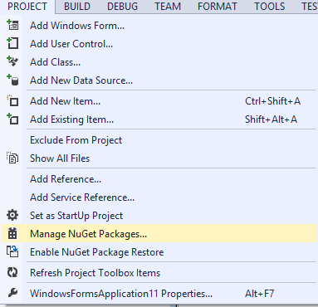
Use NuGet Packages

Slide 3
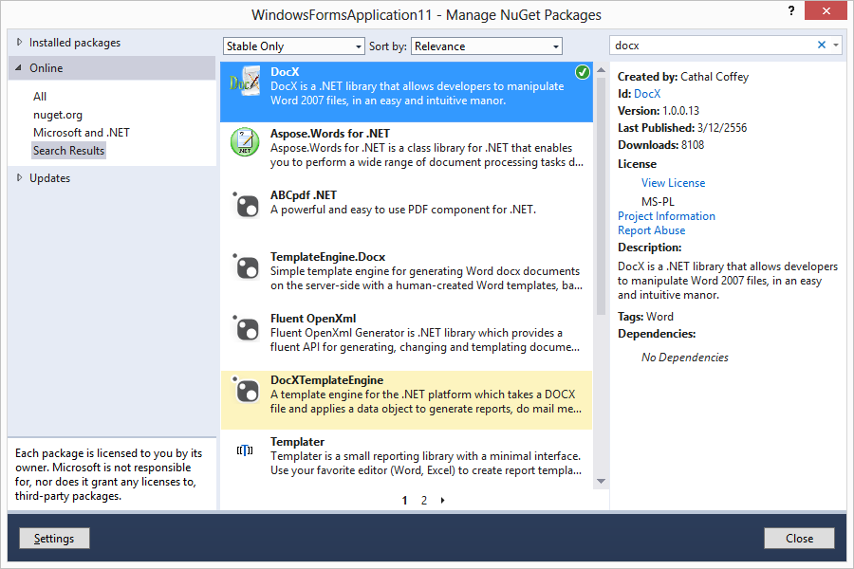

Slide 4
using System.Text;
using System.Threading.Tasks;
using System.Windows.Forms;
using Novacode;
using System.Diagnostics;

Slide 5
string fileName = @"e:\DocXExample.docx";
// Create a document in memory:
var doc = DocX.Create(fileName);
// Insert a paragrpah:
doc.InsertParagraph("This is my first paragraph");
// Save to the output directory:
doc.Save();
// Open in Word:
Process.Start("WINWORD.EXE", fileName);

Slide 6
More example
string fileName = @"e:\DocXExample2.docx";
string headlineText = "Constitution of the United States";
string paraOne = ""
+ "We the People of the United States, in Order to form a more perfect Union, "
+ "establish Justice, insure domestic Tranquility, provide for the common defence, "
+ "promote the general Welfare, and secure the Blessings of Liberty to ourselves "
+ "and our Posterity, do ordain and establish this Constitution for the United "
+ "States of America.";

Slide 7
// A formatting object for our headline:
var headLineFormat = new Formatting();
headLineFormat.FontFamily = new System.Drawing.FontFamily("Arial Black");
headLineFormat.Size = 18D;
headLineFormat.Position = 12;
// A formatting object for our normal paragraph text:
var paraFormat = new Formatting();
paraFormat.FontFamily = new System.Drawing.FontFamily("Calibri");
paraFormat.Size = 10D;
// Create the document in memory:
var doc = DocX.Create(fileName);
// Insert the now text objects;
doc.InsertParagraph(headlineText, false, headLineFormat);
doc.InsertParagraph(paraOne, false, paraFormat);
// Save to the output directory:
doc.Save();
// Open in Word:
Process.Start("WINWORD.EXE", fileName);

Slide 8
Workshop
ให้ออกรายงานของสินค้าจากร้านค้าที่ได้สร้างไว้เป็น Word และ Excel

