Slide 1

Pattern Recognition scikit-learn
Chumphol Bunkhumpornpat
Department of Computer Science
Faculty of Science
Chiang Mai University

Slide 2



Simple and efficient tools for predictive data analysis
Accessible to everybody, and reusable in various contexts
Built on NumPy, SciPy, and matplotlib
Open source, commercially usable - BSD license

Slide 3

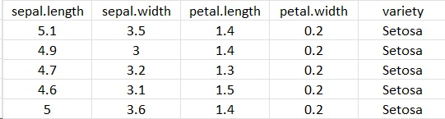
Load in the Iris Dataset
import pandas as pd
dataset = pd.read_csv("iris.csv")

Slide 4
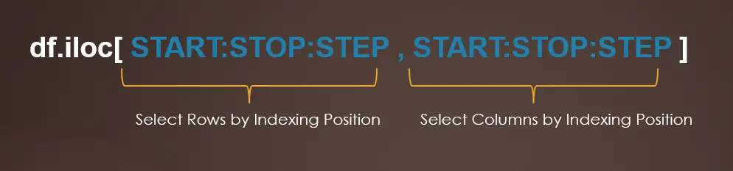
Preprocessing of Dataset
X = dataset.iloc[:,:-1]
y = dataset.iloc[:, -1]

Slide 5
Train/Test split
from sklearn.model_selection import train_test_split
X_train, X_test, y_train, y_test =
train_test_split(X, y, test_size=0.33)

Slide 6
Make Your Prediction by
K-nearest Neighbors
from sklearn.neighbors import KNeighborsClassifier
classifier = KNeighborsClassifier()
classifier.fit(X_train, y_train)
y_pred = classifier.predict(X_test)

Slide 7
Output
[150 rows x 5 columns]
[[15 0 0]
[ 0 13 0]
[ 0 3 19]]
0.94

Slide 8
sklearn.neighbors.KNeighborsClassifier
n_neighbors
  Number of neighbors to use by default for kneighbors queries
Weights
  Weight function used in prediction
Metric
  Metric to use for distance computation

Slide 9
n_neighbors : int
default = 5
Function Call:
classifier = KNeighborsClassifier(n_neighbors=1)

Slide 10
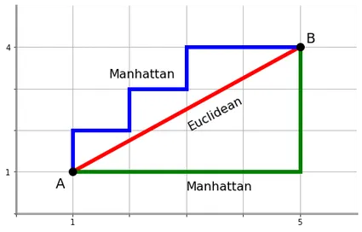
metric : {‘minkowski’, ‘manhattan’},
default = ’minkowski’
  The standard Euclidean distance when p = 2

Slide 11
Evaluating Your Algorithm
from sklearn.metrics import confusion_matrix, accuracy_score
print(confusion_matrix(y_test, y_pred))
print(accuracy_score(y_test, y_pred))

Slide 12
weights : {‘uniform’, ‘distance’},
default = "uniform’
‘uniform’ : uniform weights
  All points in each neighborhood are weighted equally.
‘distance’ : weight points by the inverse of their distance
  Closer neighbors of a query point will have a greater influence than neighbors which are further away.

Slide 13
Classical Naive Bayes vs Gaussian Naive Bayes
Classical Naive Bayes
  Categorical Features
  Multinomial Distribution
Gaussian Naive bayes
  Continuous Valued Features
  Gaussian (normal) Distribution

Slide 14
Categorical Naive Bayes
from sklearn.naive_bayes import CategoricalNB
classifier = CategoricalNB()

Slide 15
Gaussian Naive Bayes
from sklearn.naive_bayes import GaussianNB
classifier = GaussianNB()

Slide 16
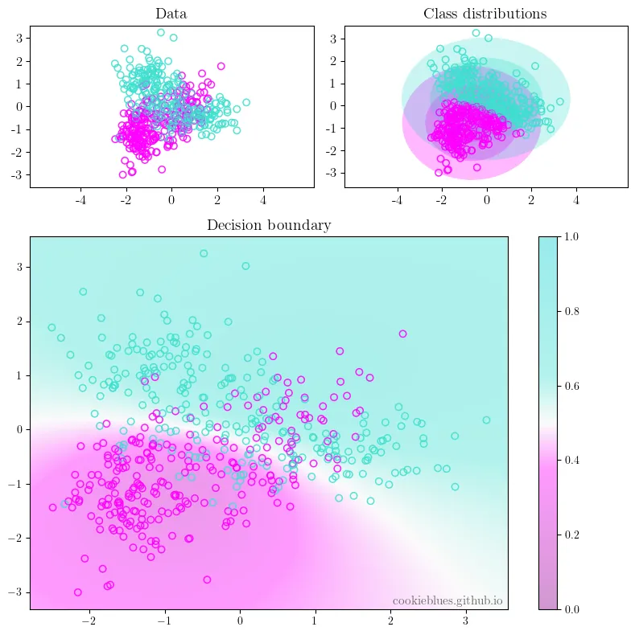

Slide 17
Decision Tree
from sklearn.tree import DecisionTreeClassifier
classifier = DecisionTreeClassifier(criterion='entropy')

Slide 18
Tree Class for Visualization
import matplotlib.pyplot as plt
from sklearn import tree
tree.plot_tree(classifier)
plt.show()

Slide 19
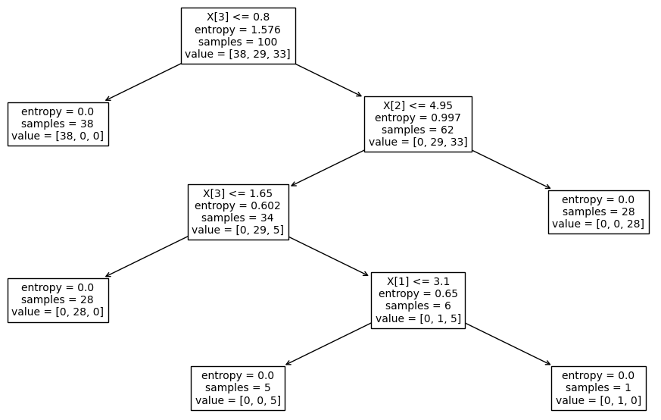

Slide 20
sklearn.tree.DecisionTreeClassifier
criterion
  The function to measure the quality of a split
max_depth
  The maximum depth of the tree.
  If None, then nodes are expanded until all leaves are pure or until all leaves contain less than min_samples_split samples.
min_samples_split
  The minimum number of samples required to split an internal node

Slide 21
Criterion : {‘gini’, ‘entropy’, ‘log_loss’}
default = ‘gini’

Slide 22
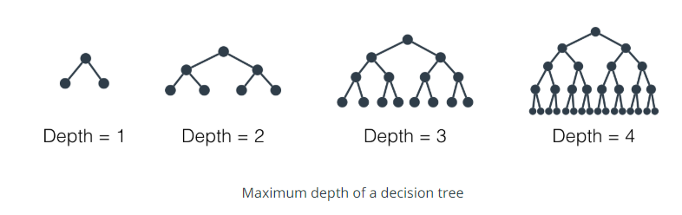
max_depth : int
default = None

Slide 23
min_samples_split : int or float
default = 2
If int, then consider min_samples_split as the minimum number.
If float, then min_samples_split is a fraction and ceil(min_samples_split * n_samples) are the minimum number of samples for each split.

Slide 24
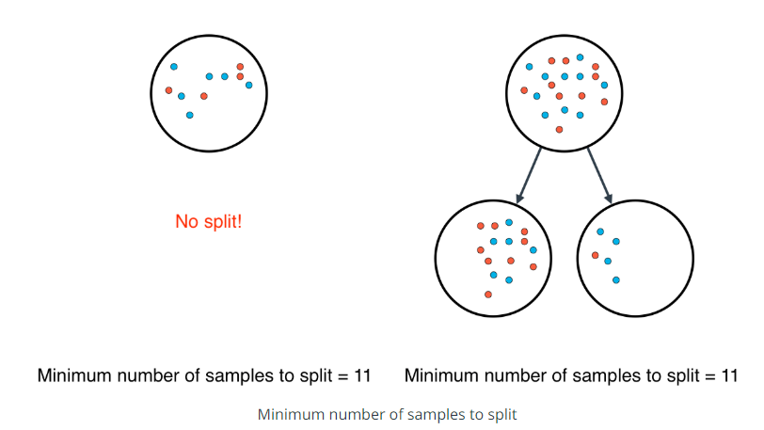

Slide 25
Random Forest
from sklearn.ensemble import RandomForestClassifier
classifier = RandomForestClassifier(n_estimators=1000 )

Slide 26
sklearn.ensemble.RandomForestClassifier
n_estimators
  The number of trees in the forest
criterion
max_depth
min_samples_split

Slide 27
n_estimators : int
default = 100

Slide 28
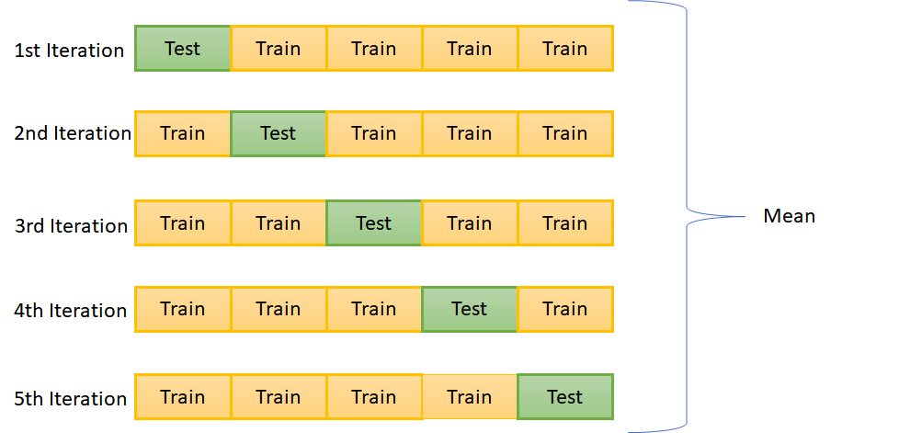
k-Fold Cross-Validation

Slide 29
k-Fold Cross-Validation
from sklearn.model_selection import KFold
from sklearn.model_selection import cross_val_score
from numpy import mean
cv = KFold(n_splits=10, random_state=1, shuffle=True)
scores = cross_val_score(classifier, X, y, scoring='accuracy', cv=cv, n_jobs=-1)
print(mean(scores))

Slide 30
sklearn.model_selection.KFold
n_splits
  Number of folds
shuffle
  Whether to shuffle the data before splitting into batches
  The samples within each split will not be shuffled
random_state
  When shuffle is True, random_state affects the ordering of the indices, which controls the randomness of each fold.
  Otherwise, this parameter has no effect
  Pass an int for reproducible output across multiple function calls

Slide 31
n_splits : int
Default = 5
Must be at least 2

Slide 32
shuffle : bool
Default = False

Slide 33
random_state : int
RandomState instance or None
Default = None

Slide 34
Random State : None
This is the default value.
This allows the function to use the global random state instance from np.random
If you call the same function multiple times with random_state=None, that function will produce different results across different executions.

Slide 35
Random State : int
We can use an integer for random_state
We can use any integer including 0, but not negative ones, only positive integers
The most popular integers are 0 and 42
When we use an integer for random_state, the function will produce the same results across different executions
The results are only changed if we change the integer value

Slide 36

Why is Random State Always 42?

Slide 37
Feature Scaling
from sklearn.preprocessing import StandardScaler
scaler = StandardScaler()
scaler.fit(X_train)
X_train = scaler.transform(X_train)
X_test = scaler.transform(X_test)

Slide 38
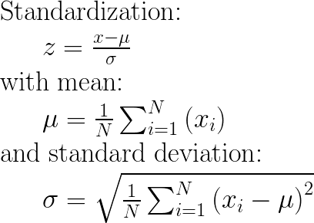

Slide 39
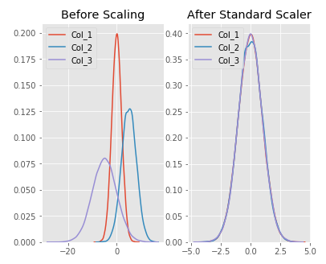

Slide 40
References
https://scikit-learn.org/stable/index.html
https://www.kdnuggets.com/2022/07/knearest-neighbors-scikitlearn.html
https://machinelearningmastery.com/how-to-configure-k-fold-cross-validation/
https://towardsdatascience.com/why-do-we-set-a-random-state-in-machine-learning-models-bb2dc68d8431

Slide 41
Image Sources:
https://sparkbyexamples.com/pandas/pandas-iloc-usage-with-examples/
https://www.omnicalculator.com/math/manhattan-distance
https://towardsdatascience.com/gaussian-naive-bayes-4d2895d139a
https://julienbeaulieu.gitbook.io/wiki/sciences/machine-learning/decision-trees
https://machinelearninggeek.com/cross-validation-in-scikit-learn/
https://www.hotstar.com/in/movies/the-hitchhikers-guide-to-the-galaxy/1260018023
https://michael-fuchs-python.netlify.app/2019/08/31/feature-scaling-with-scikit-learn/

