Slide 1

Pattern Recognition in
Computer Games
Chumphol Bunkhumpornpat
Department of Computer Science
Faculty of Science
Chiang Mai University

Slide 2


Slide 3
Google AI beats top human players at strategy game StarCraft II
AlphaStar was built by Google’s AI firm DeepMind.
a machine capable of learning or understanding any task that humans can
AlphaStar has 1,026 actions to choose from at any moment.
DeepMind limited the speed of AlphaStar’s reflexes to that of experienced human players.
AlphaStar placed within the top 0.5% of all players on the European server.

Slide 4
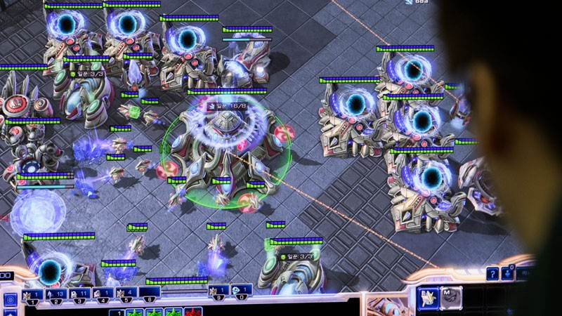
StarCraft II players battle each other in a futuristic warzone.

Slide 5
Introduction
Computer games are an unique application area for pattern recognition.
Challenging synthetic opponents computer should recognize the behavior of a human player.
The purpose of pattern recognition is to abstract relevant information from the game world and to construct concepts and to deduce patterns from this information.

Slide 6
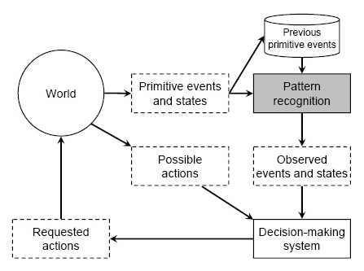
Relations between the world, pattern recognition, and decision-making

Slide 7
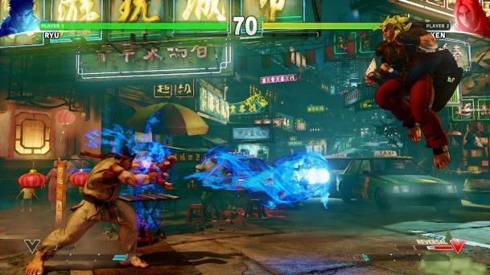
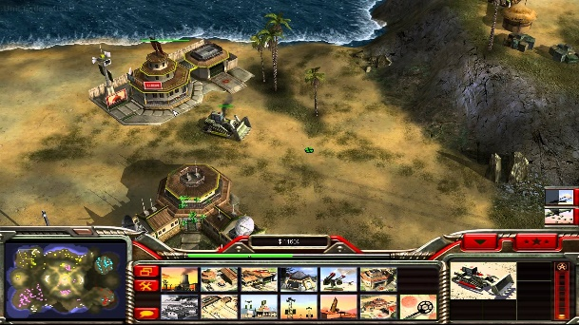
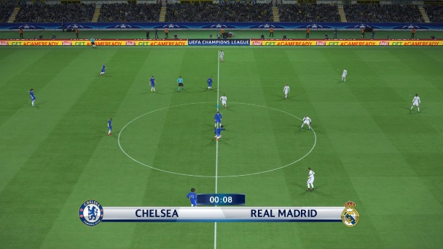
Pattern Recognition in Computer Games
Fighting
reacts to enemy's frequent moves
RTS: Real-Time Strategy
remedies threats and strategizes
Sports
reads the match

Slide 8
Perspective Views of Pattern Recognition in computer games
Decision Making Levels
Stance Towards Players
Game Graphs

Slide 9
Decision Making Levels
Strategical
Tactical
Operational

Slide 10
Strategical
Long Period of Time
Large Amount of Data
  Inhabitants
  Items
  Events
High Cost of a Wrong Decision
Speculative: What-If Scenarios
Offline: Background

Slide 11
Operational
Concrete
Atomatory Entities
Reactive
Short-Term
Real-Time
Online: in-the-Field
Irrevocable Problems

Slide 12
Tactical
connects between strategical and operational
considers a group of entities and their cooperation
made more frequently than strategical, pattern recognition has less time to use
The quality cannot be as high as on upper level.

Slide 13
Stance Towards Players
Enemy
Ally
Neutral

Slide 14
Enemy
requires modus operandi of the player
provides challenge

Slide 15
Ally
accounts human perspective but not decision making system
Synthetic Reconnaissance Officer
  It reports on enemy movement.
  It suggests effective counteractions.

Slide 16
Neutral
Autonomous Camera Director
  controls camera movement in sports games
  dictates by television practice
Referee
  allows the play continue
  interprets causality between offence and subsequent events
Interface should adapt dynamically to the needs of a player.

Slide 17
Game Graph
A story progresses linearly.
A game provides an illusion of free will.
Nodes
  Game States
Direct Arches
  Actions
The game properties can be analyzed through graph concepts (e.g., repetitiveness corresponds to cycles in the graph).

Slide 18
Outdegree
The number of direct arches leaving a node
The greater the outdegree means more freedom the player has.

Slide 19
Indegree
The number of direct arches entering the node
Uniqueness of a response can be measured as the indegree.

Slide 20
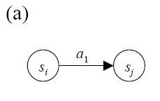
A linear (a story) allows no diversion

Slide 21
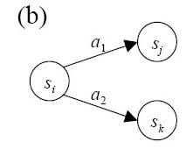
node S_{i} has an outdegree of 2

Slide 22
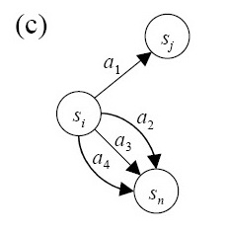
node S_{n} has an indegree of 3.

Slide 23
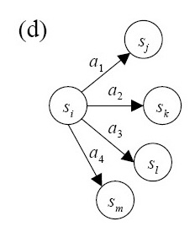
Each action has now a unique response

Slide 24
References
T. Kaukoranta, J. Smed, and H. Hakonen, Role of Pattern Recognition in Computer Games, Proceedings of the 2nd International Conference on Application and Development of Computer Games, pp. 189--94, Hong Kong SAR, China, 2003.
https://www.nature.com/articles/
d41586-019-03298-6

Slide 25
