Slide 1

Pattern Recognition
Association Rules and Rule-based Classifiers
Chumphol Bunkhumpornpat
Department of Computer Science
Faculty of Science
Chiang Mai University

Slide 2
Outline
Market Basket Analysis
Association Rules
Apriori Algorithm
Rule-based Classifiers

Slide 3
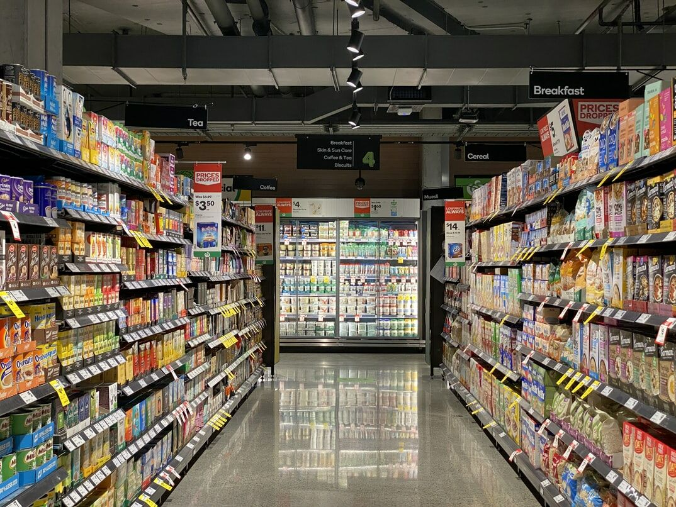

Slide 4
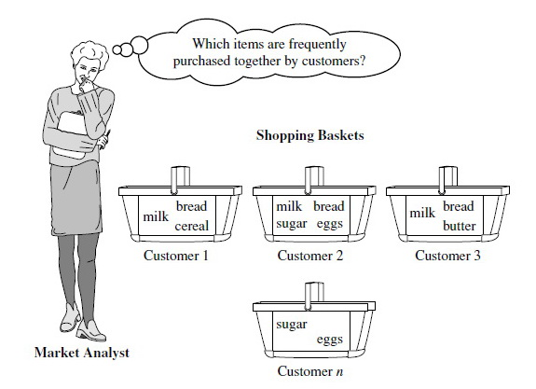
Market Basket Analysis

Slide 5


Slide 6


Slide 7
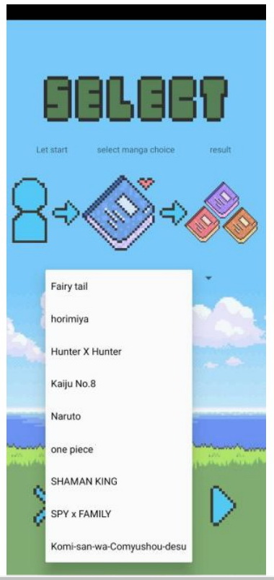
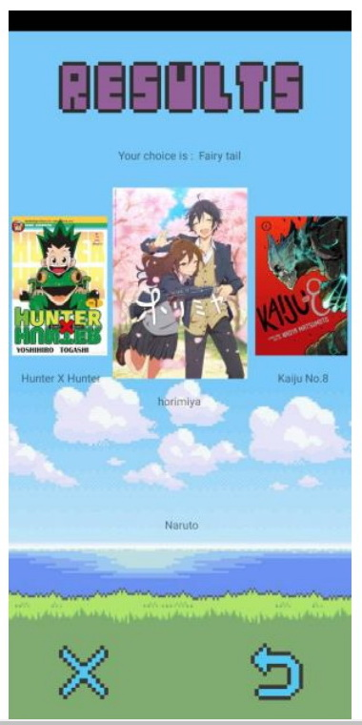

Slide 8
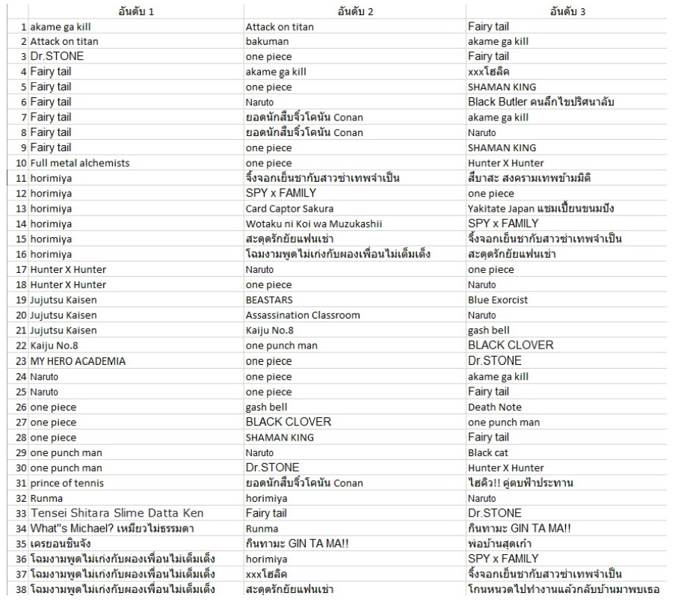

Slide 9
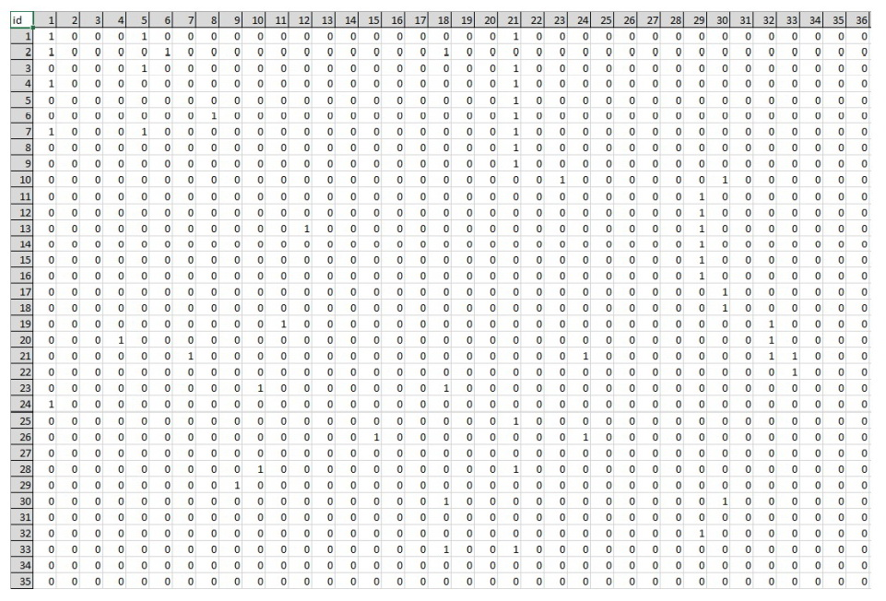

Slide 10
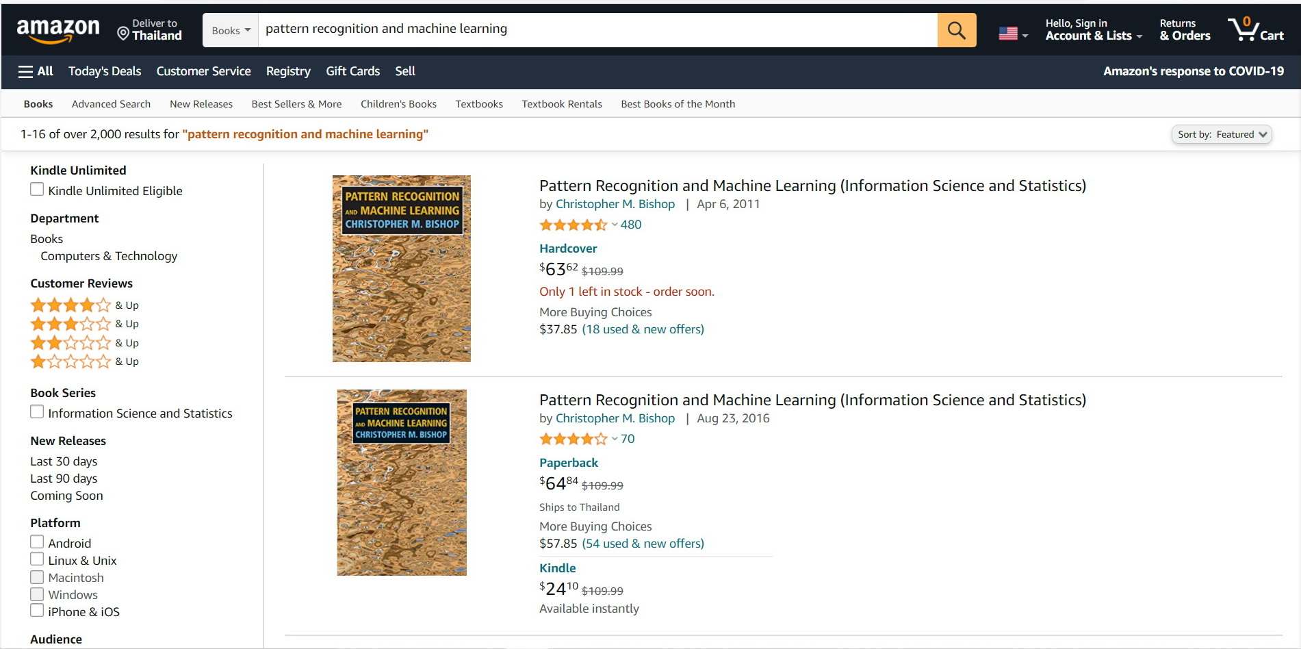

Slide 11
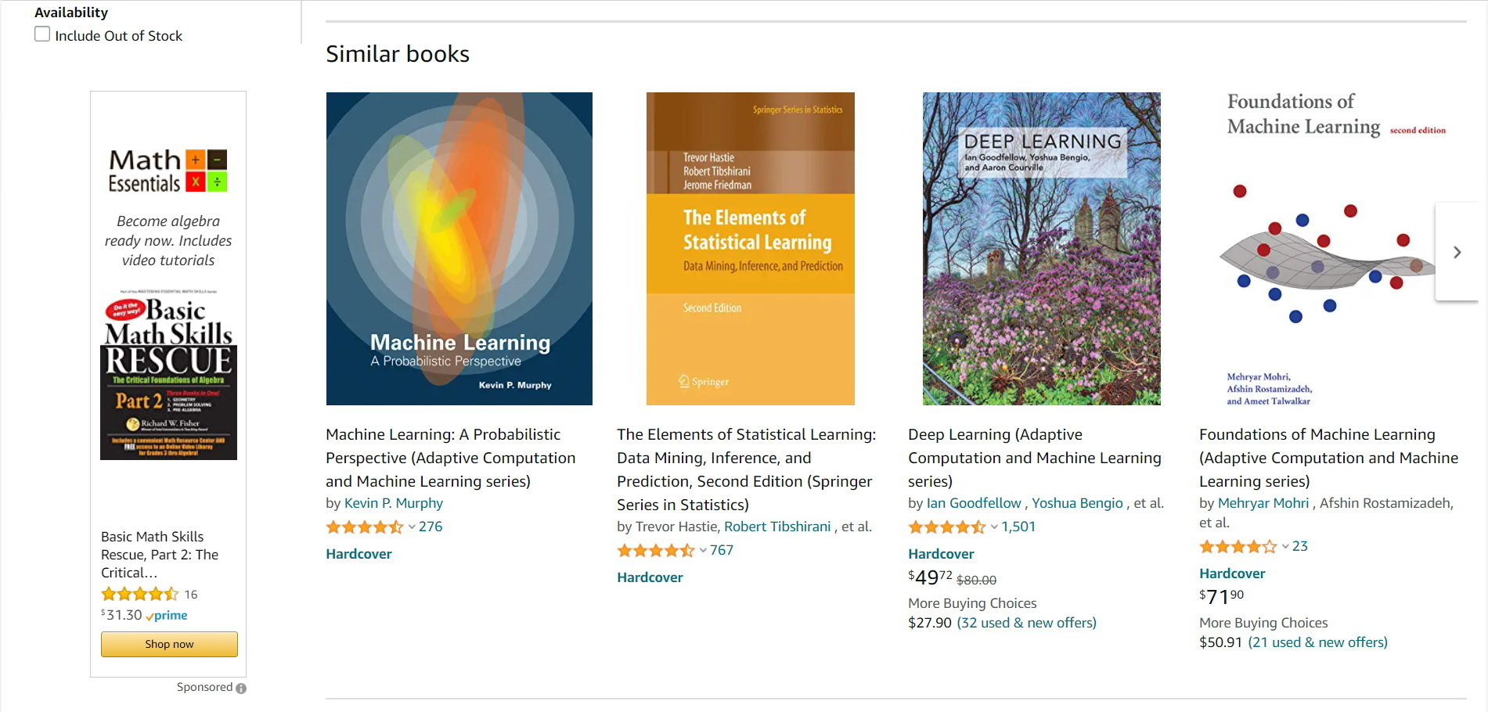

Slide 12
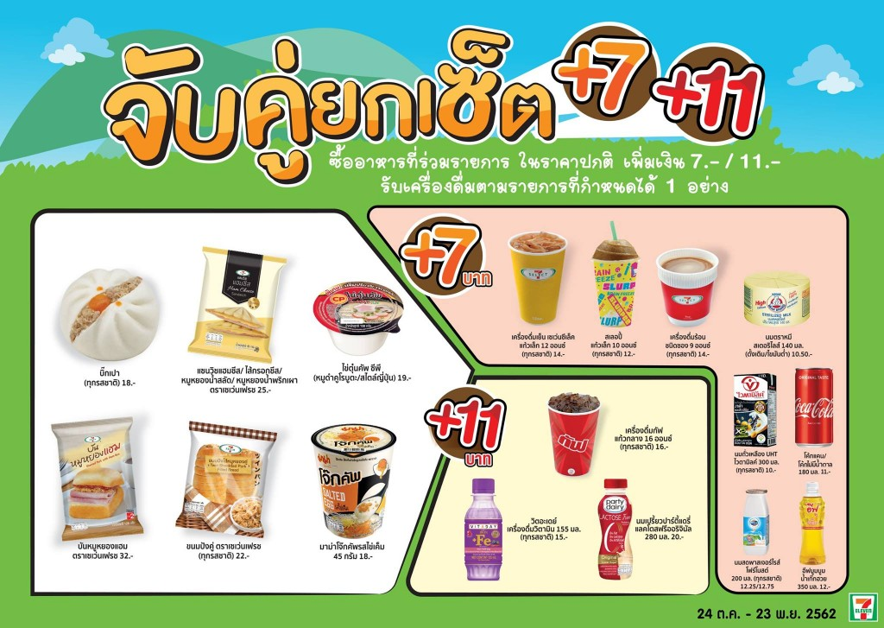

Slide 13


Slide 14
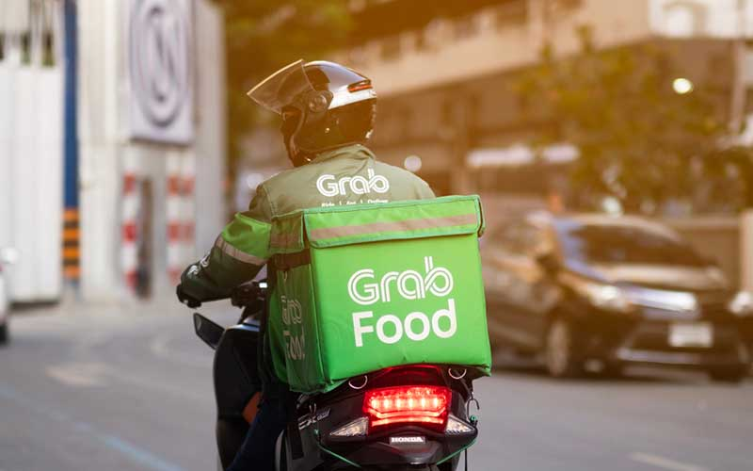

Slide 15
Apriori Algorithm

Slide 16
Itemset
A set of items together is called an itemset.
If any itemset has k-items it is called
a k-itemset.
An itemset that occurs frequently is called
a frequent itemset.
frequent itemset mining is a data mining technique to identify the items that often occur together.

Slide 17
Frequent Itemset
A set of items is called frequent if it satisfies a minimum threshold value for support and confidence.
Support shows transactions with items purchased together in a single transaction.
Confidence shows transactions where the items are purchased one after the other.

Slide 18
computer → antivirus
[support = 2%, confidence = 60%]
A support of 2% for this rule means that 2% of all the transactions under analysis show that computer and antivirus software are purchased together.
A confidence of 60% means that 60% of the customers who purchased a computer also bought the software.

Slide 19
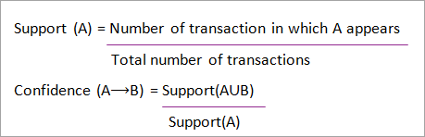

Slide 20
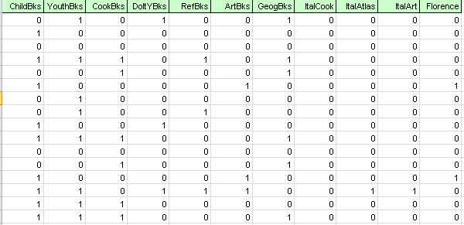
Dataset

Slide 21
Apriori Algorithm
Join Step: This step generates (K+1) itemset from K-itemsets by joining each item with itself.
Prune Step: This step scans the count of each item in the database. If the candidate item does not meet minimum support, then it is regarded as infrequent and thus it is removed. This step is performed to reduce the size of the candidate itemsets.

Slide 22
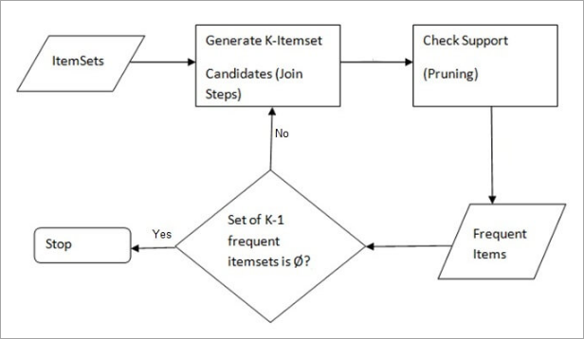

Slide 23
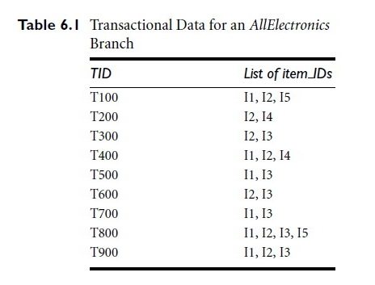
Transactional Data

Slide 24
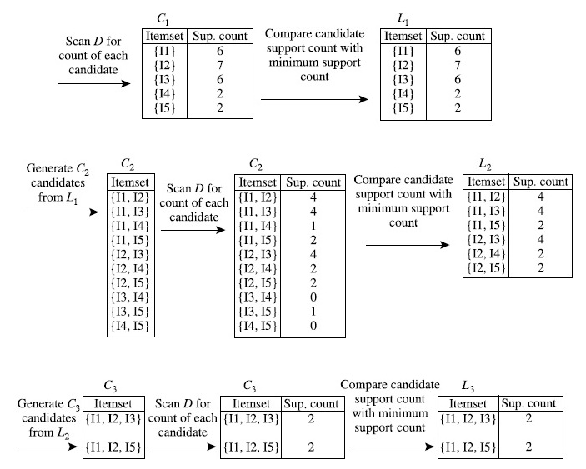
Apriori Algorithm: minimum support count = 2

Slide 25
Generating Association Rules
{I1,I2} → I5, confidence = 2/4 = 50%
{I1,I5} → I2, confidence = 2/2 = 100%
{I2,I5} → I1, confidence = 2/2 = 100%
I1 → {I2,I5} confidence = 2/6 = 33%
I2 → {I1,I5} confidence = 2/7 = 29%
I5 → {I1,I2} confidence = 2/2 = 100%

Slide 26
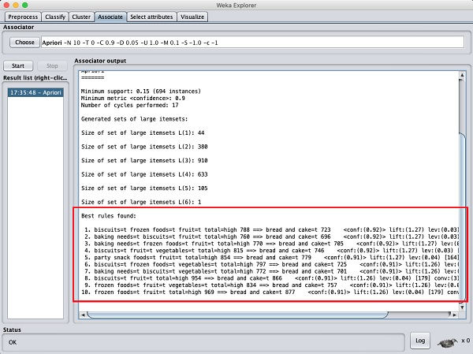

Slide 27
RULE-BASED Classifiers

Slide 28
0R Classifier
0R = “Zero Rule”
is the simplest classification method
which relies on the target
ignores all predictors
ZeroR classifier simply predicts the majority category (class)
no predictability power in ZeroR
it is useful for determining a baseline performance as a benchmark for other classification methods.

Slide 29
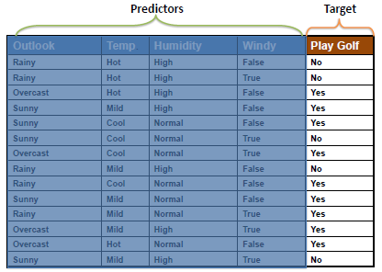
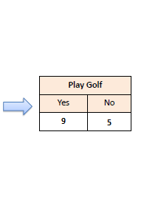
"Play Golf = Yes" is the ZeroR model for the following dataset with an accuracy of 0.64

Slide 30
1R Classifier
1R = "One Rule“
generates one rule for each predictor in the data
selects the rule with the smallest total error as its "one rule“
create a rule for a predictor, construct a frequency table for each predictor against the target.
OneR produces rules only slightly less accurate than state-of-the-art classification algorithms while producing rules that are simple for humans to interpret.

Slide 31
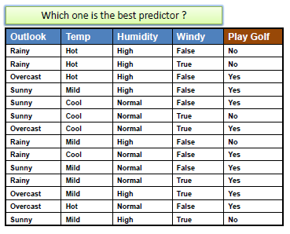
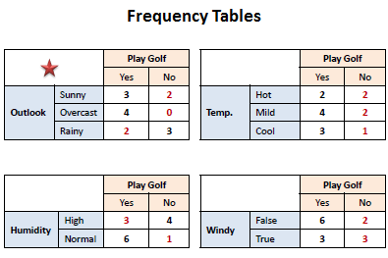

Slide 32
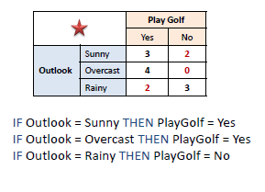

Slide 33
Decision Stump
Consisting of a one-level decision tree
it is a decision tree with
  one internal node (the root) which is immediately connected to the terminal nodes (its leaves)
makes a prediction based on the value of just a single input feature
Sometimes they are also called 1-rules

Slide 34
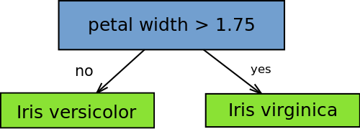
Decision Stump

Slide 35
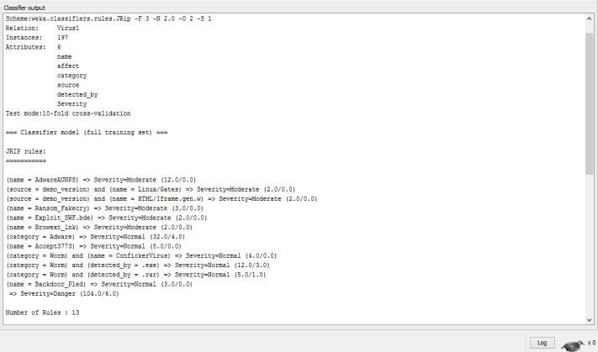
JRIP in Weka

Slide 36
Reference
Han, J., Kamber, M., Pei, J.: Data Mining: Concepts and Techniques, 3rd Edition. Morgan Kaufman (2011)
https://www.softwaretestinghelp.com/apriori-algorithm/

