Slide 1
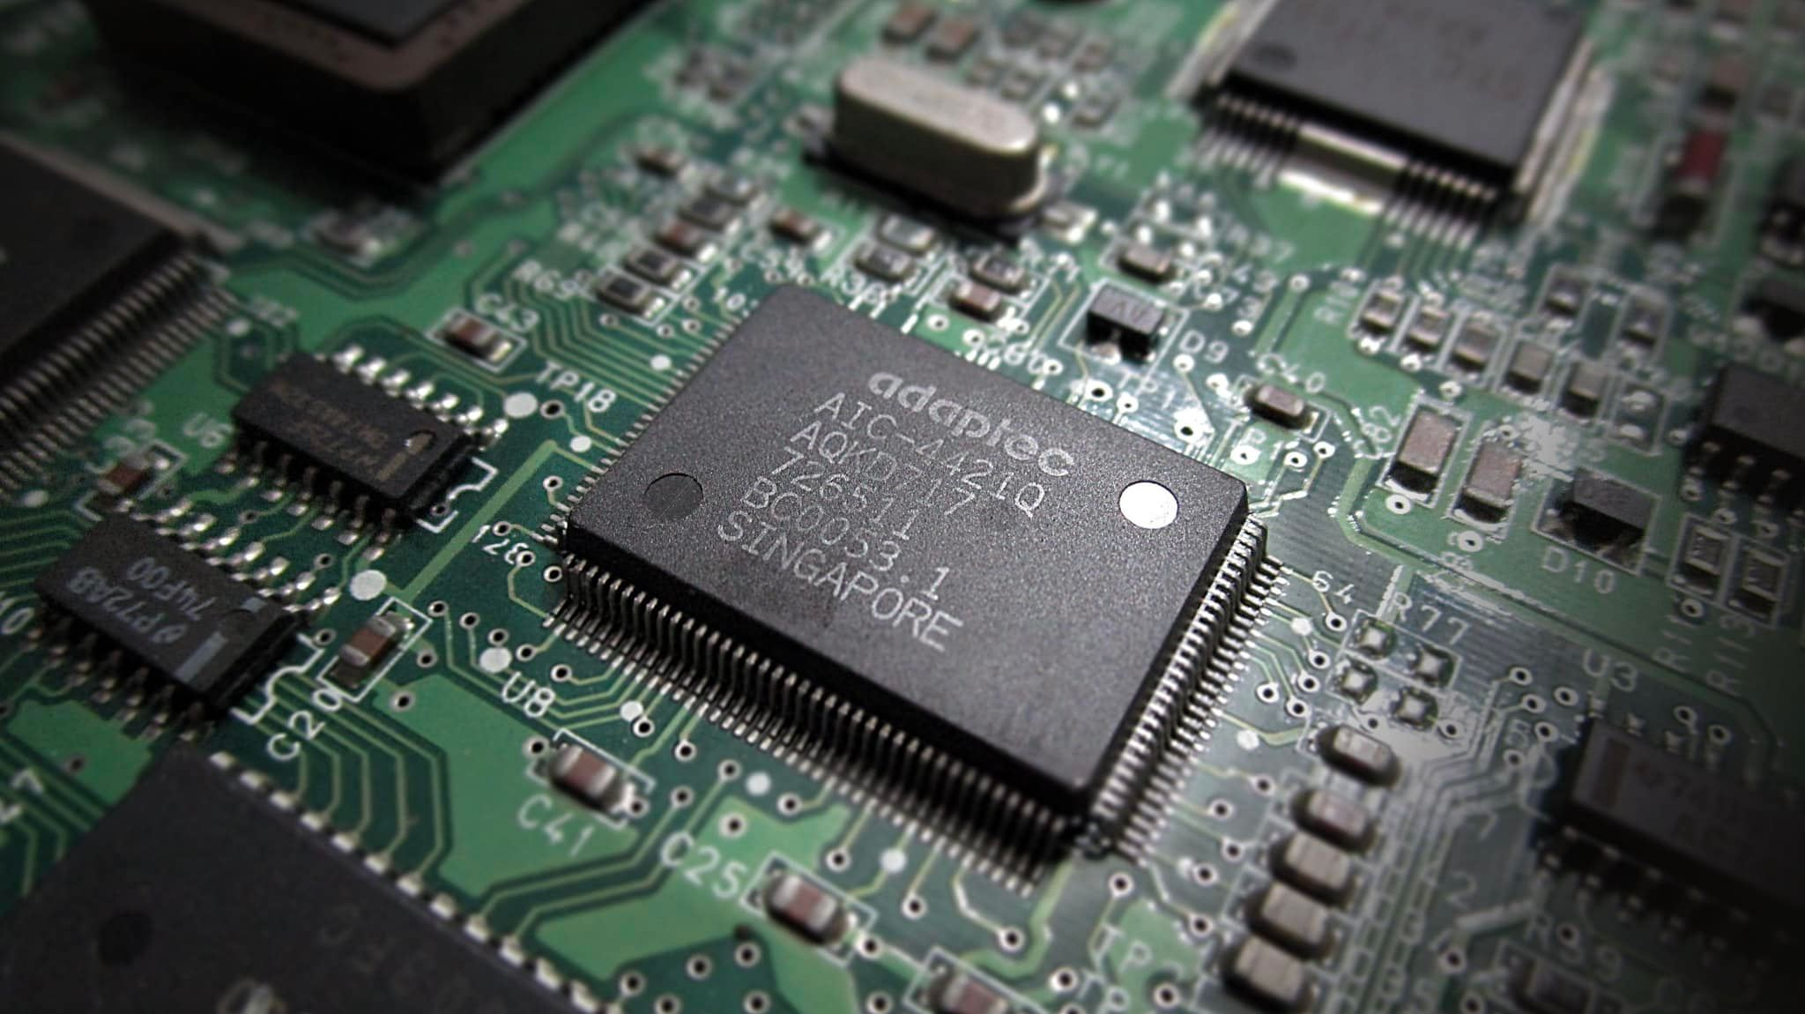
204231
Computer Organization and Architecture

Slide 2



204231: Computer Organization and Architecture
Integrated Circuit Design
Low-level Programming Language

Slide 3
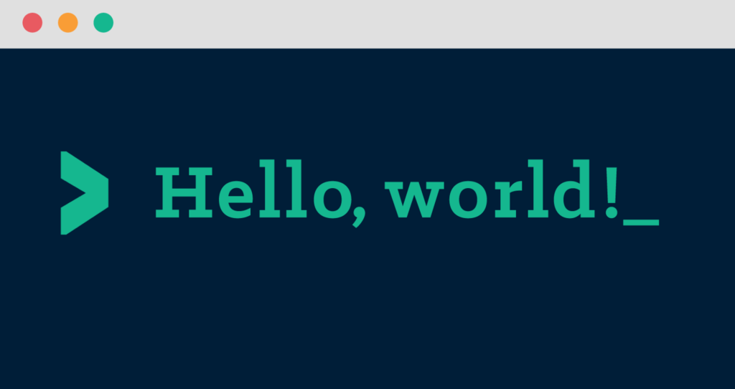

Slide 4
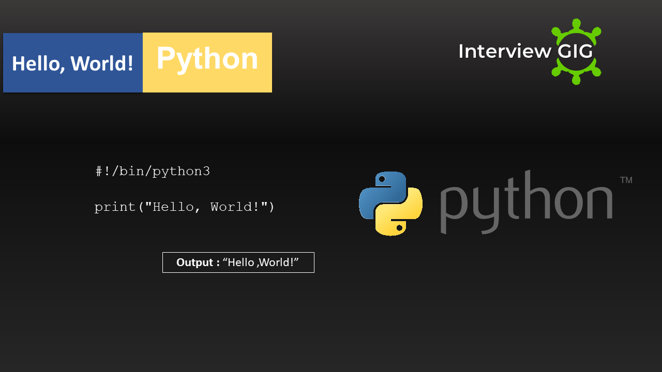

Slide 5
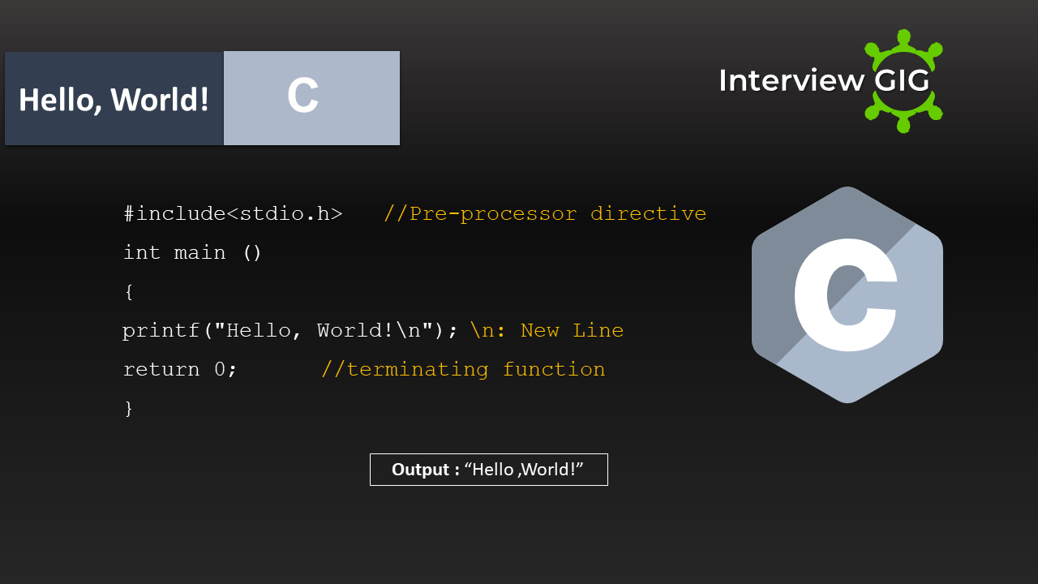

Slide 6
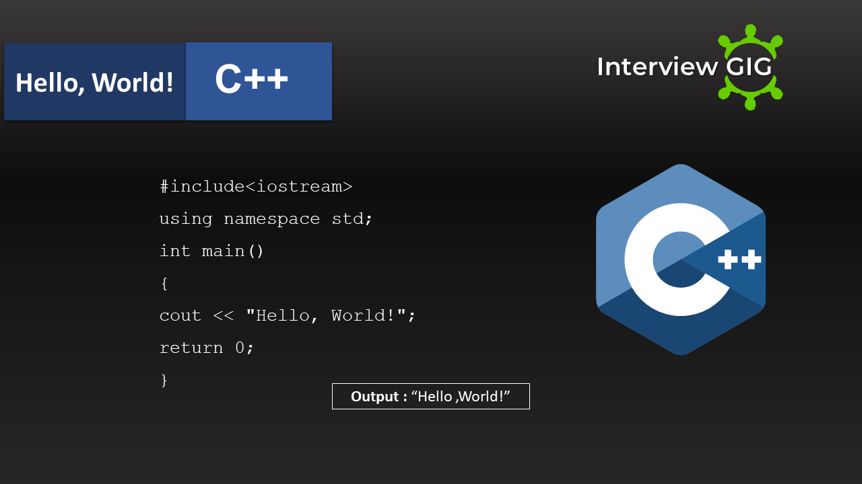

Slide 7
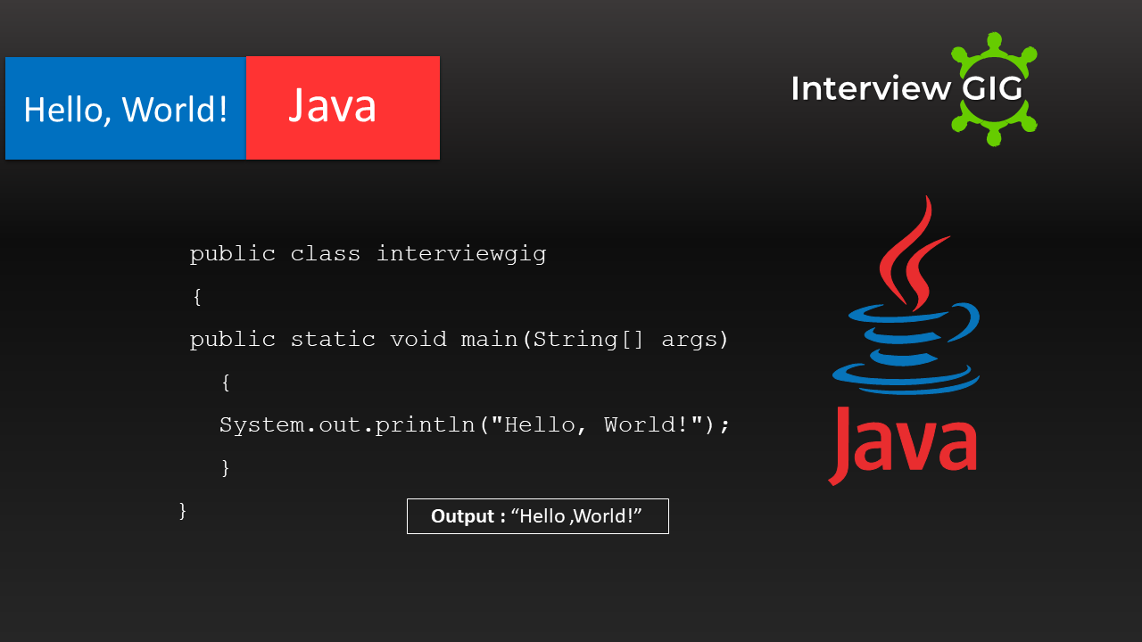

Slide 8
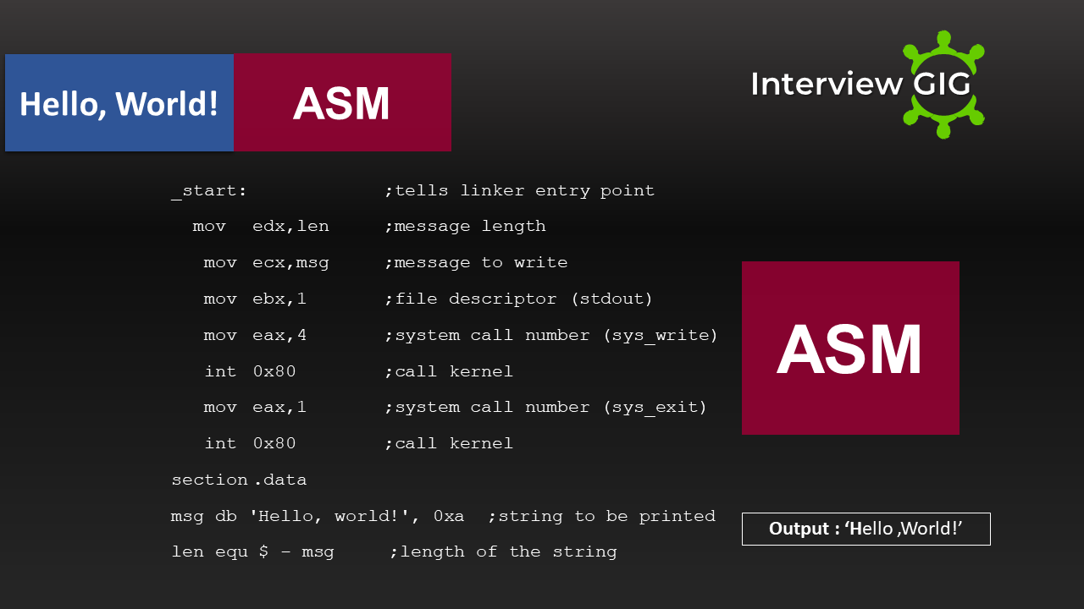

Slide 9


Slide 10
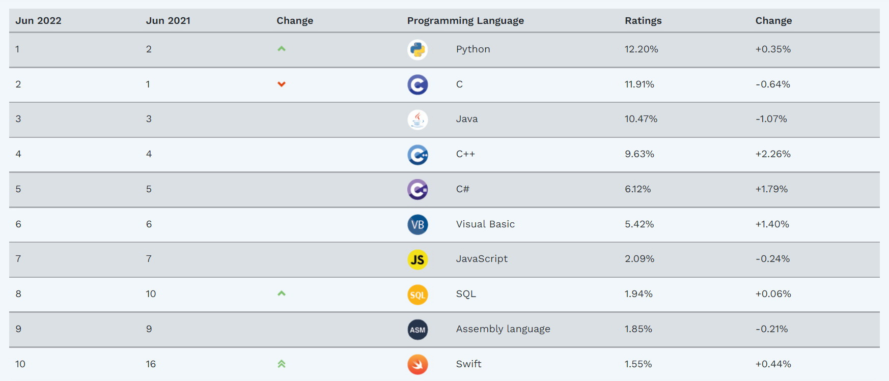

Slide 11
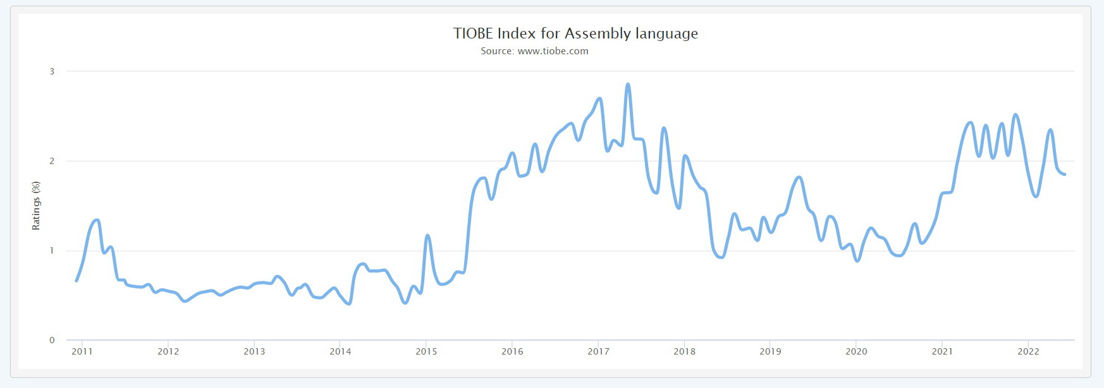

Slide 12
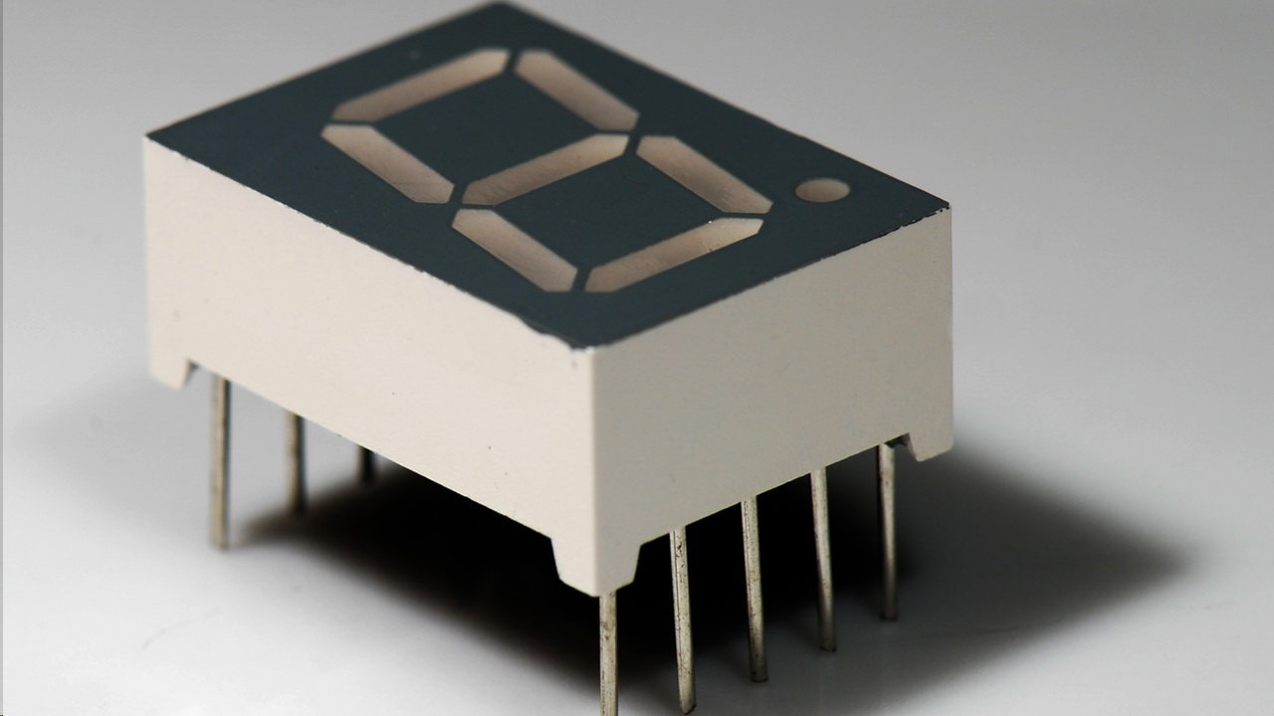
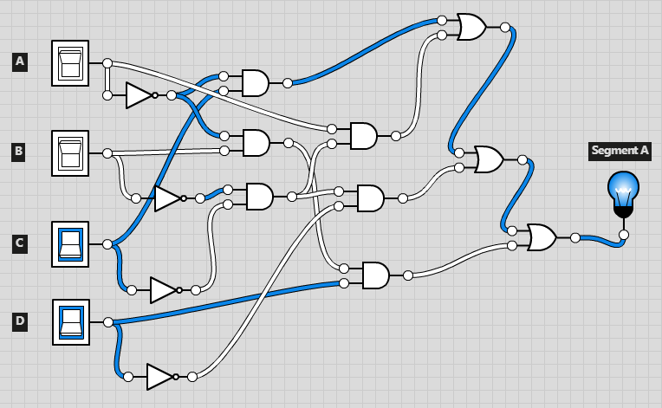
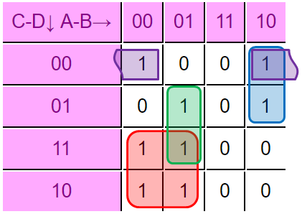
















7 Segment LED Display

Slide 13


Slide 14
Sources
https://www.tiobe.com/tiobe-index/
https://www.interviewgig.com/hello-world-in-different-programming-languages/

